Slide 1
Dr. Sunirmal Khatua
Consensus Algorithms
in Distributed Computing
By
Visvesvaraya Young Faculty Fellow, Govt. of India
Assistant Professor, University of Calcutta
Notes:
We celebrate Christmas to remember the birth of Jesus Christ

Slide 2
What is Consensus Algorithm?
Getting a group of processes in a distributed system to agree on a value.
Properties of Consensus Algorithm:
Termination : Eventually every non-faulty processes decides some value.
Agreement : All non-faulty processes select the same value.
Validity : The value must be proposed by some process.
Usage of Consensus Algorithm:
Leader Election
Mutual Exclusion (Distributed Locks)
Atomic Commit in Distributed Transactions.
Managing Cluster membership – Node Join / Node Failure
Synchronizing replicated state machines ensuring all replica have the same (consistent) view of the system state
Blockchain ….

Slide 3
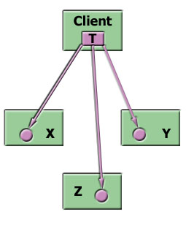
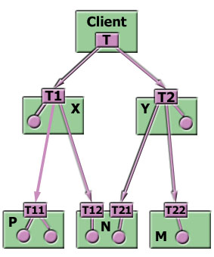
Atomic Commit in Distributed Transactions
TC₁
TC_{n}
TM₁
TM_{n}
Flat Transaction
Site₁
Site_{n}
Each site contains two subsystems:
Transaction Manager (TM):
It manages the execution of those transaction (sub-transaction) that access data in that site.
Each sub-transaction may either be a local or a part of global transaction.
Transaction Coordinator (TC):
It coordinates the execution of various transaction (both local & global) initiated at that site
For nested transaction, it is also responsible for breaking a transaction into a number of sub-transactions & distributing them to appropriate sites.
Nested Transaction

Slide 4
Two Phase Commit (2PC) Algorithm
Consider a transaction T initiated at site S_{i}, where the transaction coordinator is C_{i}
When all sites where T has executed inform C_{i} that T has completed – C_{i} starts the 2PC Protocol. Assuming no failures occur, the protocol consists of two phases:
Phase-1:
Ci adds a record <Prepare T> to the log and forces the log onto stable storage.
It then sends <Prepare T> message to all the sites where T were executed.
On receiving such a message, the TM at that site decide whether it is willing to commit.
If the answer is ‘no’ , it adds a record <Abort T> to the stable log & responds by sending <abort T> message to C_{i}.
If the answer is ‘yes’ , it adds a record <Ready T> to the stable log & responds by sending <ready T> message to C_{i}.
Phase-2:
When C_{i} receives responds to <Prepare T> message from all the sites or timeout occurs, C_{i} can determine whether T can be committed or aborted.
Transaction T can be committed, if C_{i} receives <Ready T> message from all the sites. Otherwise T must be aborted.
Depending on the situation either a record <Commit T> or <Abort T> is added to the stable log. C_{i} then sends either a <Commit T> or <Abort T> message to all the sites.
When a site receives that message, it records it into log and sends <ACK T> to C_{i}
On receiving <ACK T> from all the sites, C_{i} adds the record <Complete T> to the log.
Phase 1 Completed
Coordinator
Participant
Phase 2 Completed
Init
Receive <Prepate T>
Init
Send <Ready T>
Send <Abort T>
Send <Prepate T>
Receive <Abort T>
Wait
Wait
Abort
Timeout or receive <Abort T> from at least one site
Receive all <Ready T>
Receive <Commit T>
Send <ACK T>
Send <Commit T>
Commit
Abort
Send <Abort T>
Commit
Completed
Send <ACK T>
Receive <ACK T>
Receive <ACK T>
Completed

Slide 5
Recovery : Failure of Participating Site
When a participating site, S_{p} recovers from a failure, it examines its log to determine the fate of those transactions T that were in the midst of execution during failure.
If the log contains <Commit T> record, the site executes Redo(T)
If the log contains <Abort T> record, the site executes Undo(T)
If the log contains <Ready T> record, the site must consult C_{i} to determine the fate of T:
If C_{i} is Up, it notifies S_{p} whether T has committed or aborted. Accordingly S_{p} executes Redo(T) or Undo(T)
If C_{i} is Down, S_{p} tries to know the fate of T from other sites by sending a <QueryStatus T> message to all the sites.
On receiving such a message, a Site consults its log to find out whether T has been committed or aborted. The site notifies S_{p} accordingly.
If no site has appropriate information at that time, S_{p} must periodically resent the <QueryStatus T> message to other sites until it gets the desired information.
If the log contains no control information (<Commit T>, <Abort T> or <Ready T>), then S_{p} failed before responding to <Prepare T> message. So C_{i} must have aborted T. Hence S_{p} must execute Undo(T).

Slide 6
Recovery : Failure of Coordinator
If the Coordinator fails in the midst of execution of a transaction T, then the participating site must decide the fate of T.
If an active site contains <Commit T> record in its log, then T must be committed. The <Commit T> message is then periodically sent to all participating sites until an <ACK T> message is received from all of them. The coordinator then writes <Complete T> record to its stable log.
If an active site contains <Abort T> record in its log, then T must be aborted. The <abort T> message is then periodically sent to all participating sites until an <ACK T> message is received from all of them. The coordinator then writes <Complete T> record to its stable log.
If some active site doesn’t contain a <Ready T> record in its log, then T should be aborted.
Otherwise all active sites must have a <Ready T> record in their log. In such a situation, all participating sites wait for the decision from the coordinator.

Slide 7
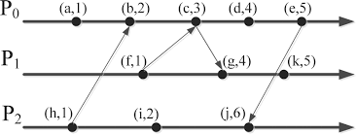

Event Ordering using Lamport’s Logical Clock
LC1: Each time a local event takes place, increment LC by 1.
LC2: When sending a message, append the value of LC to the message.
LC3: When receiving a message, set the value of LC to 1+ max (local LC, message LC).
Ordering of Events:
When a process receives a message, it is put into a local queue, ordered by its LC value.
The process then multicasts this information to other processes.
Other processes acknowledge it if they don’t have any event with lower LC value.
A message that is at the head of the queue & has been acknowledged by all other processes can be processed.

Slide 8
Popular Distributed Consensus Algorithms
1. Raft — Most popular used in Kubernetes, CockroachDB, HashiCorp (IaC)
2. Paxos — Used in many Google Services and Microsoft Azure
3. Zab — Used in apache ZooKeeper which is used in HDFS, Kafka streaming

